Slide 1

Deep Water
Jo-fai (Joe) Chow
Data Scientist
joe@h2o.ai
Paris Machine Learning Meetup
Murex
21st September, 2016

Slide 2
Agenda
This Talk (30 mins)
About H2O.ai
Demos
Web Interface
R
H2O Use Cases
Why H2O?
Moving Forward
New developments (e.g. Deep Water)
Second Talk (30 mins)
Deep Water
Demos
H2O + mxnet
H2O + TensorFlow
Third Talk (45 mins)
H2O + Spark = Sparkling Water
Demos
H2O + Spark MLlib
2

Slide 3
Deep Learning in H2O

Slide 4
H2O Overview
4

Slide 5

A Simple Neural Network
Image credit: http://cs231n.github.io/
5

Slide 6
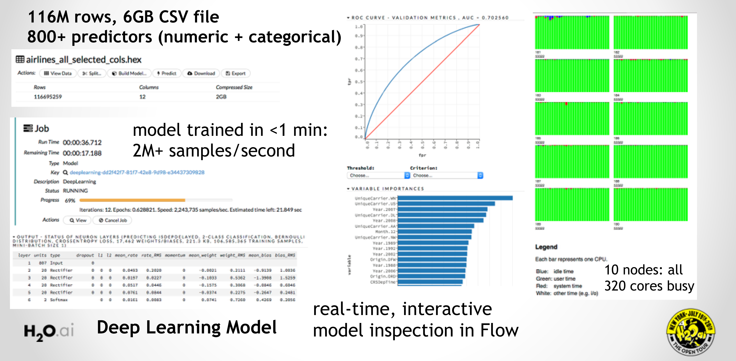
H2O Deep Learning in Action

Slide 7
H2O Deep Learning Community Quotes

Slide 8
H2O Deep Learning Community Quotes

Slide 9
Why Deep Water?

Slide 10
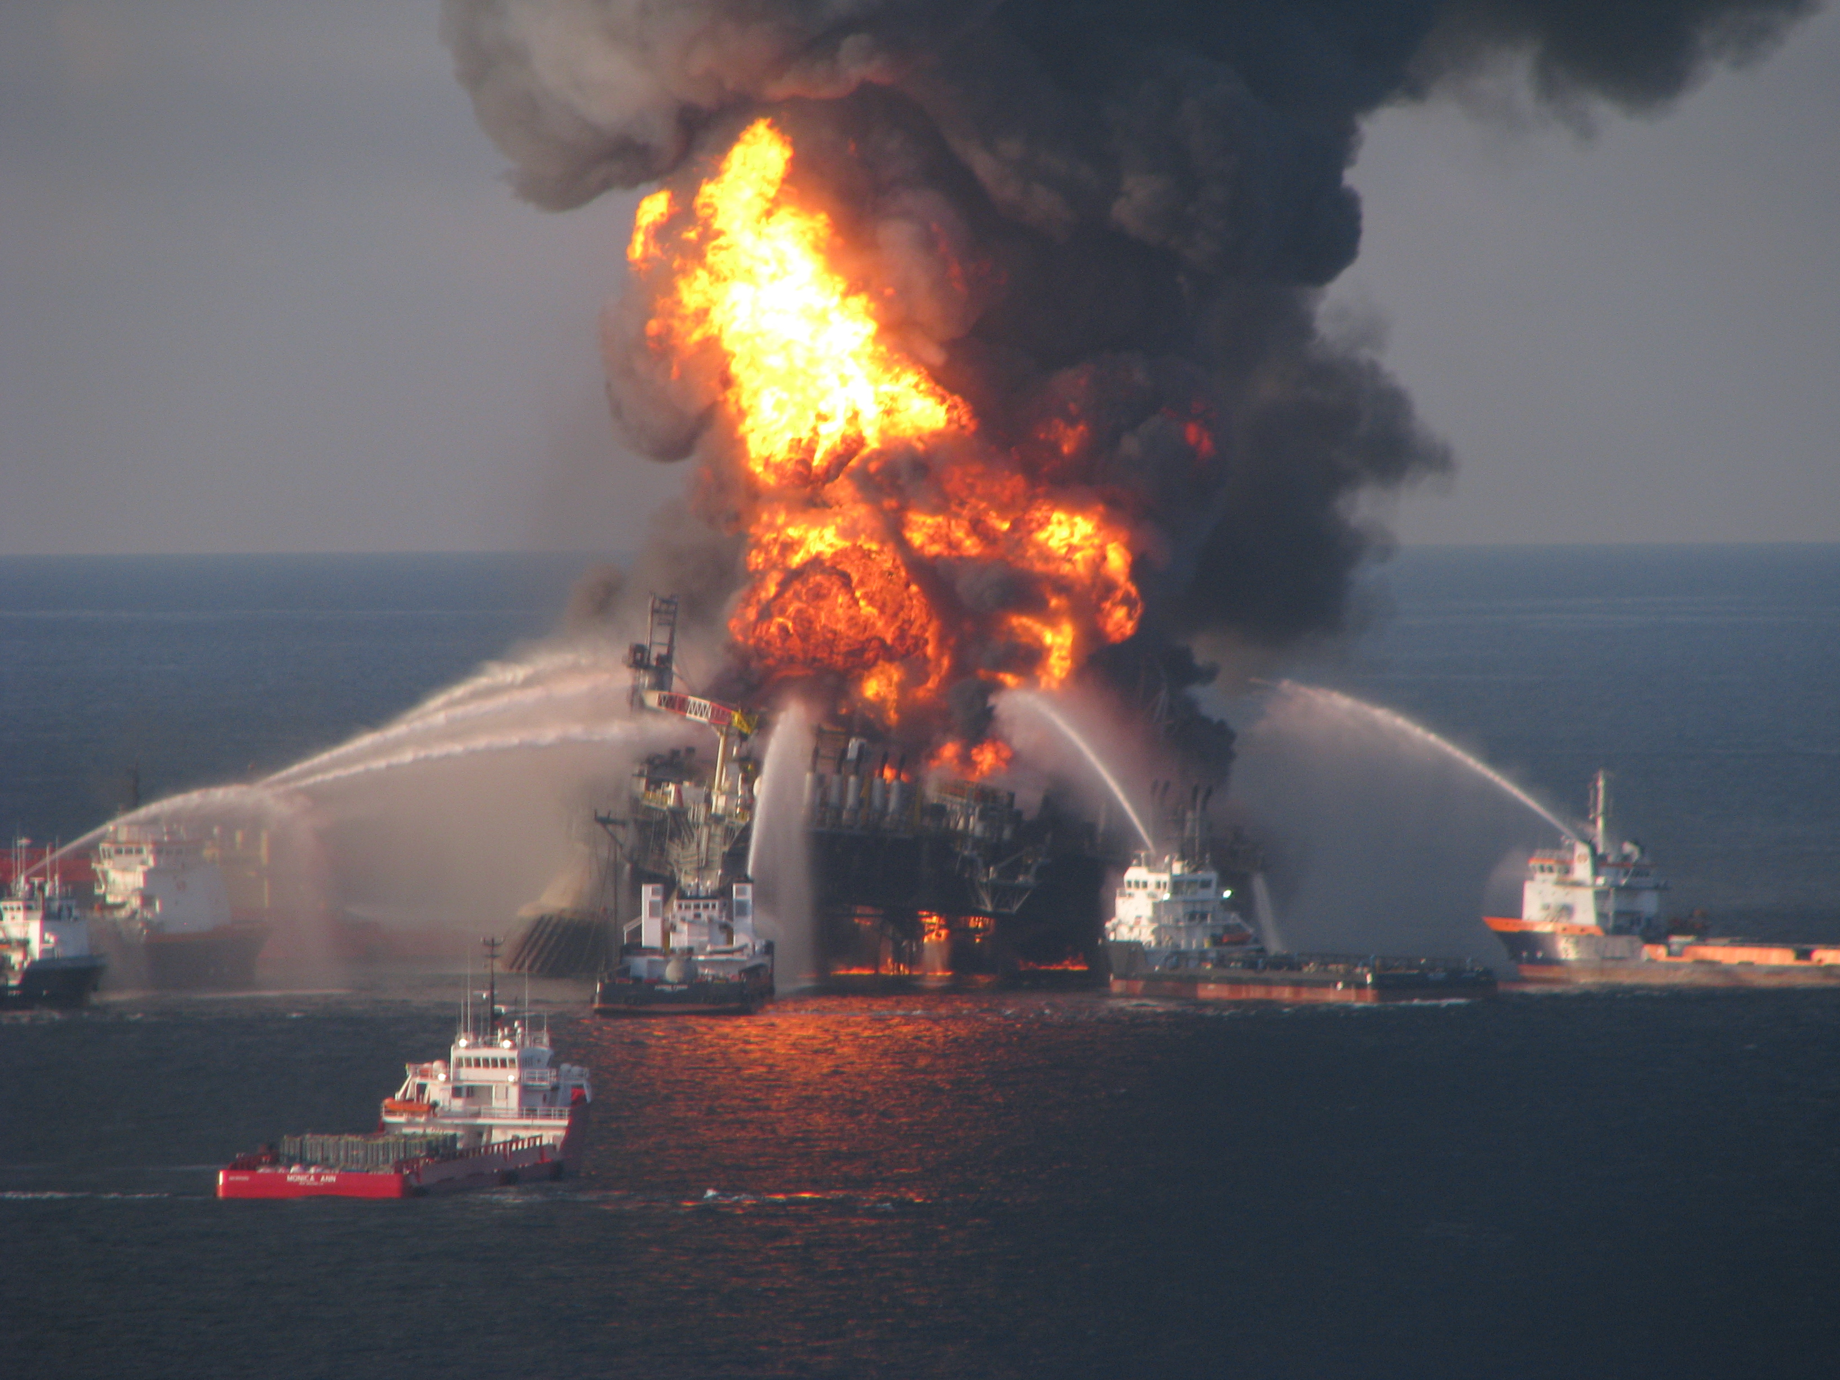

What is Deep Water?
Photo credit: en.wikipedia.org/wiki/Deepwater_Horizon_explosion

Slide 11
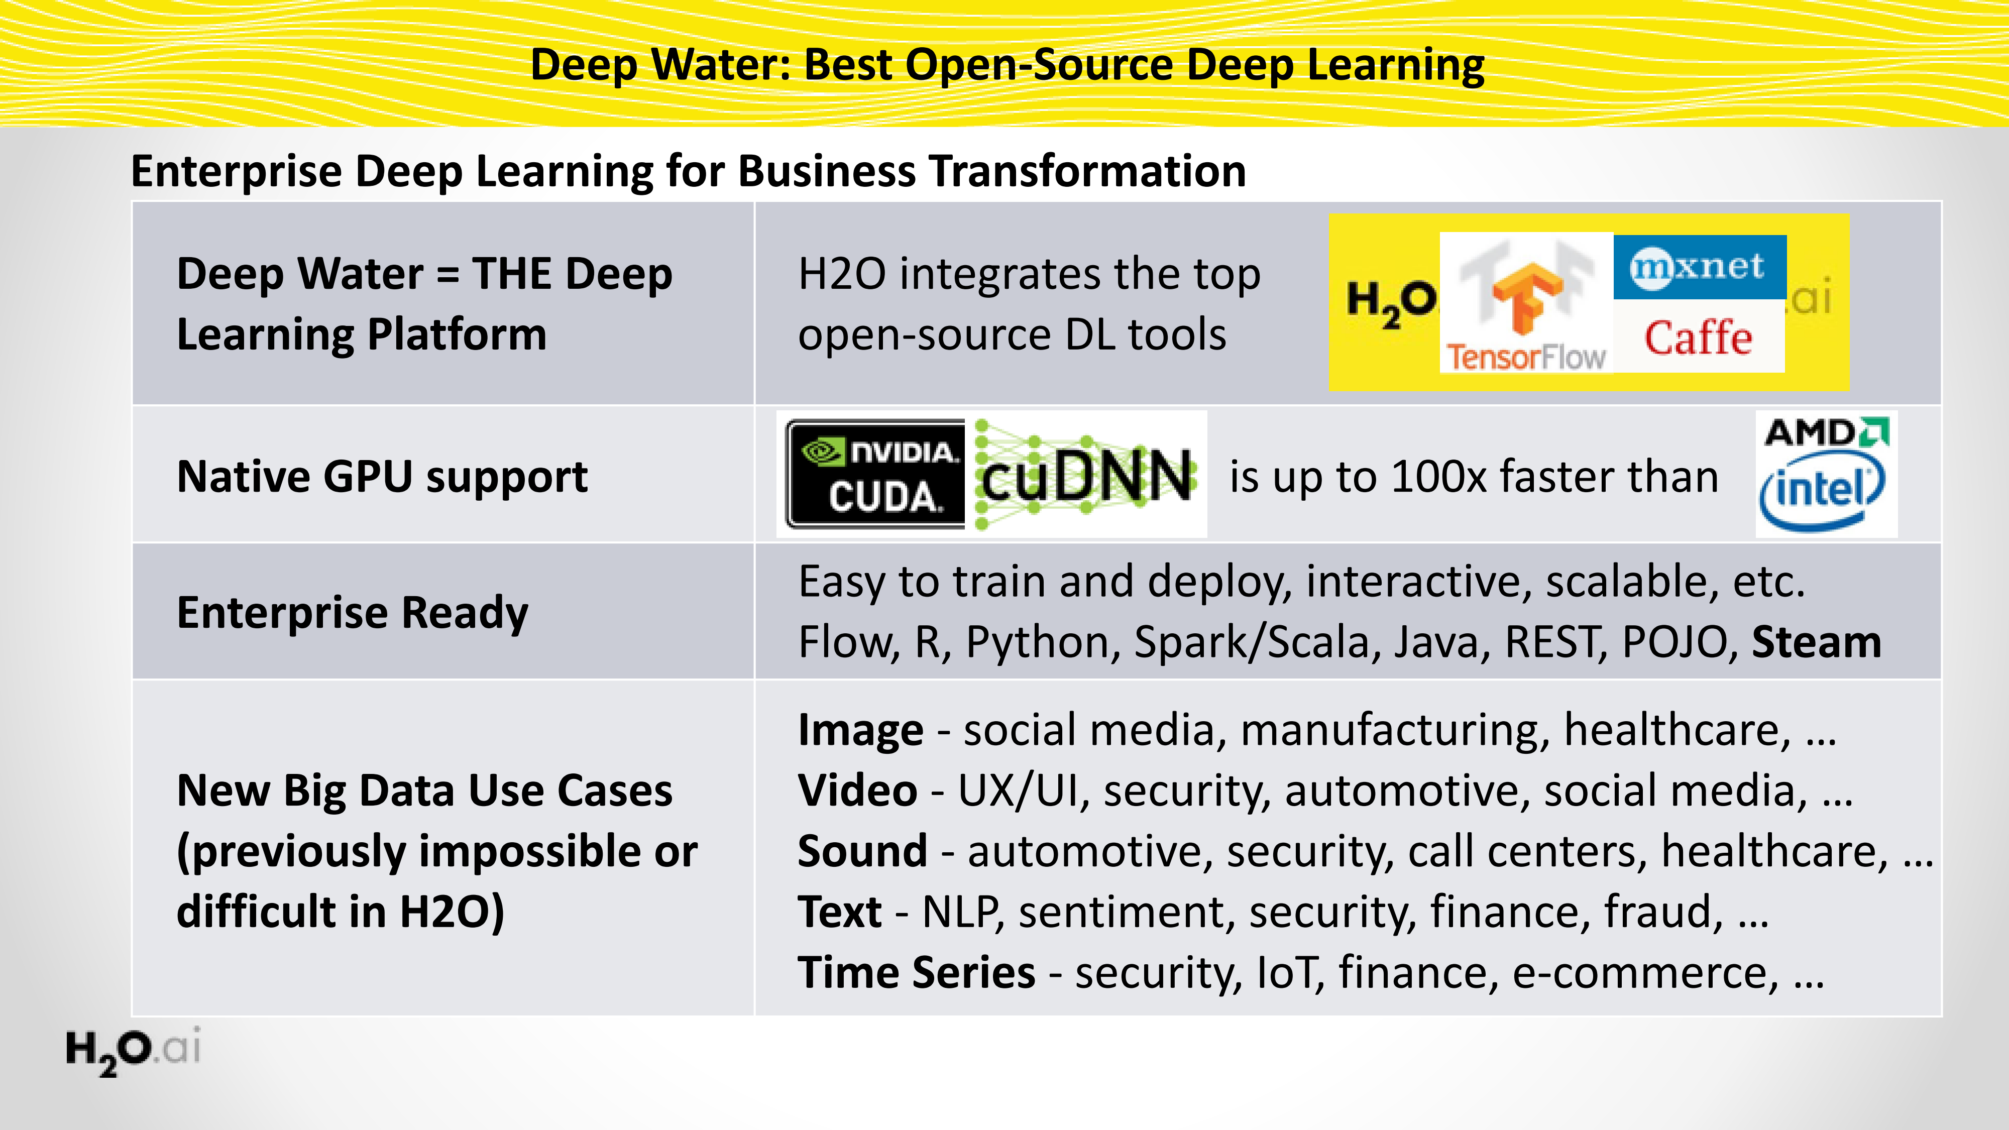
Deep Water: Next-Gen Deep Learning in H2O

Slide 12
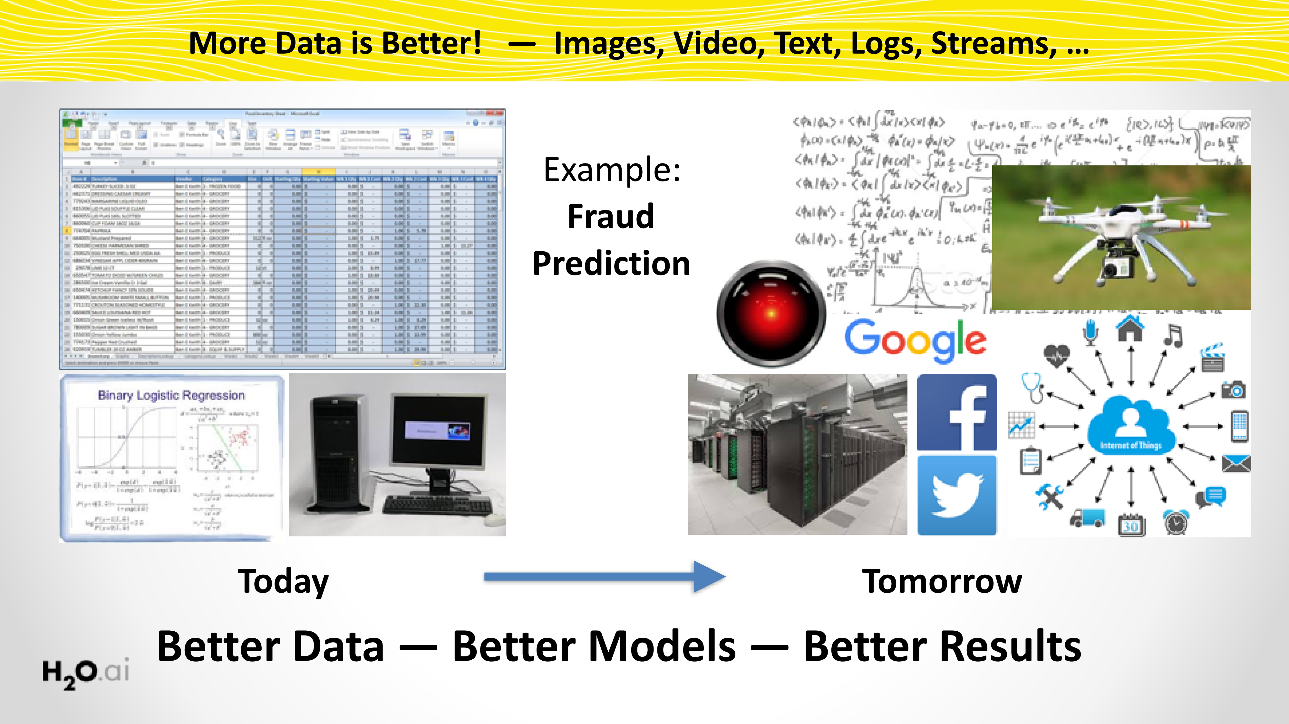
Deep Water opens the Floodgates for State-of-Art Deep Learning
12

Slide 13
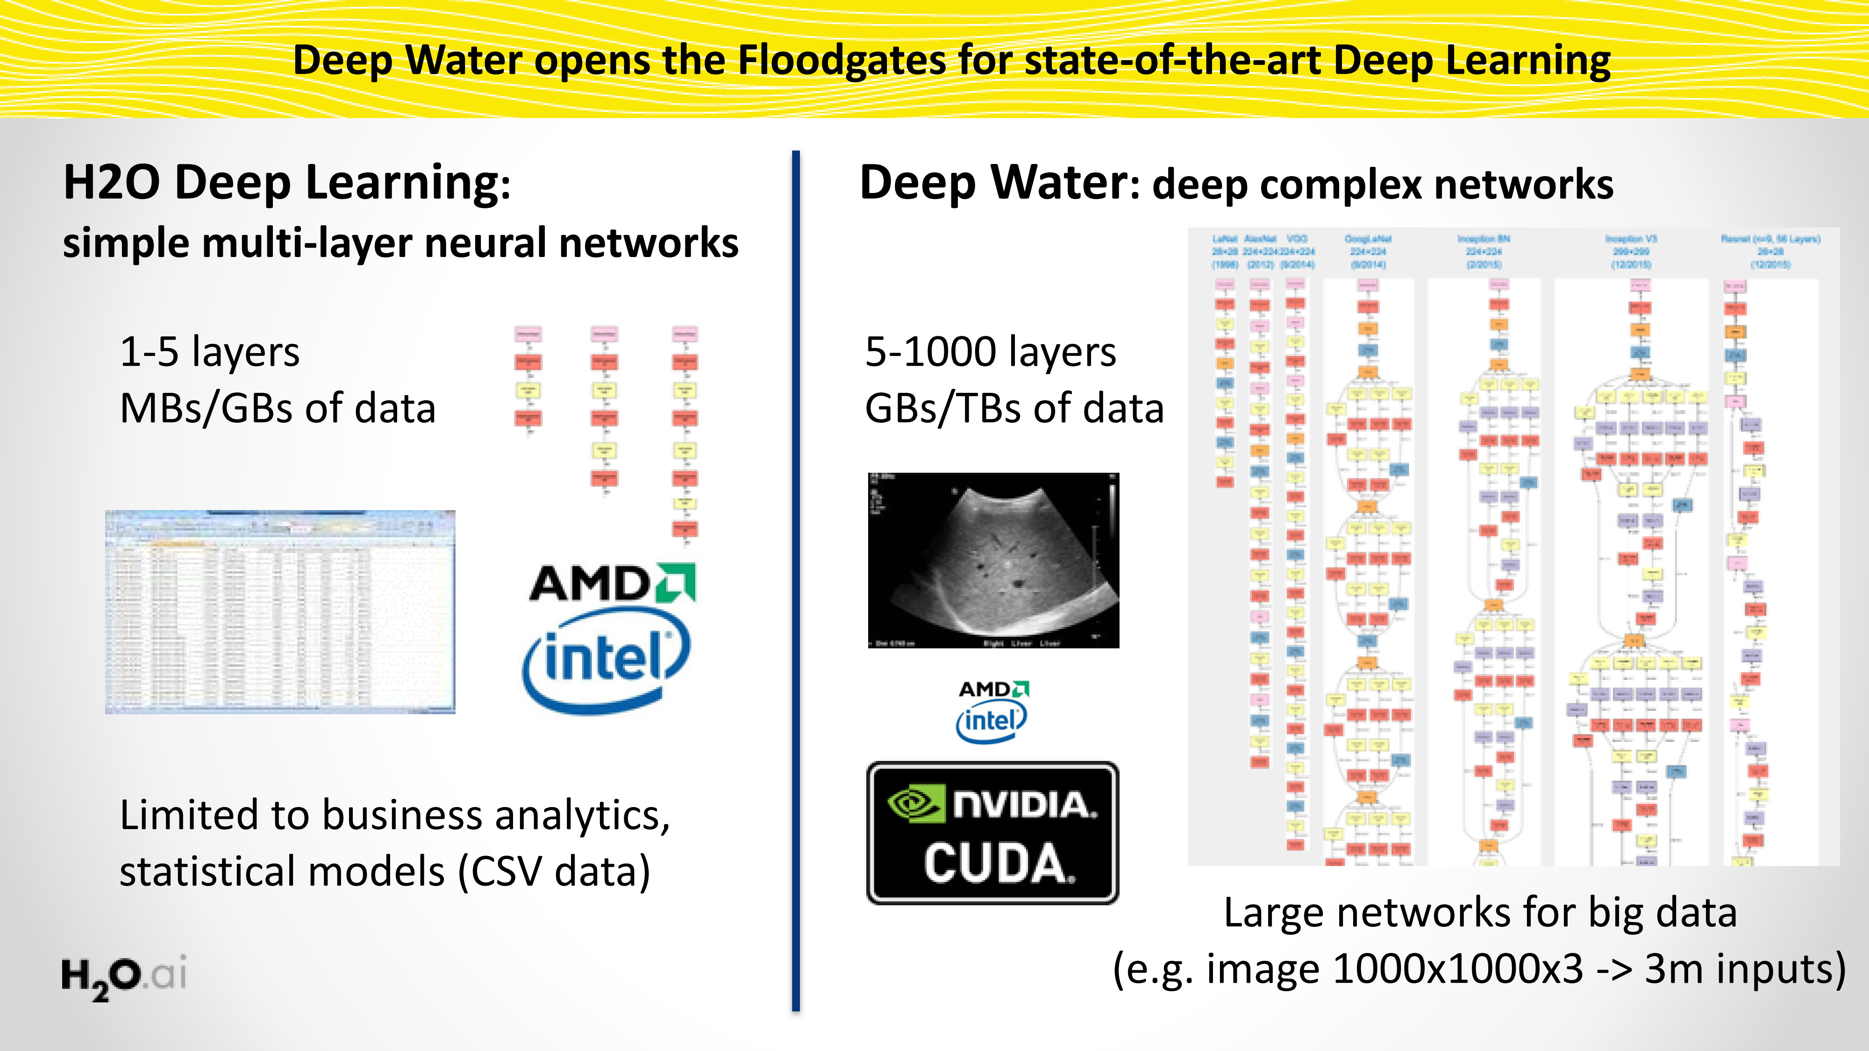
Deep Water opens the Floodgates for State-of-Art Deep Learning
13

Slide 14
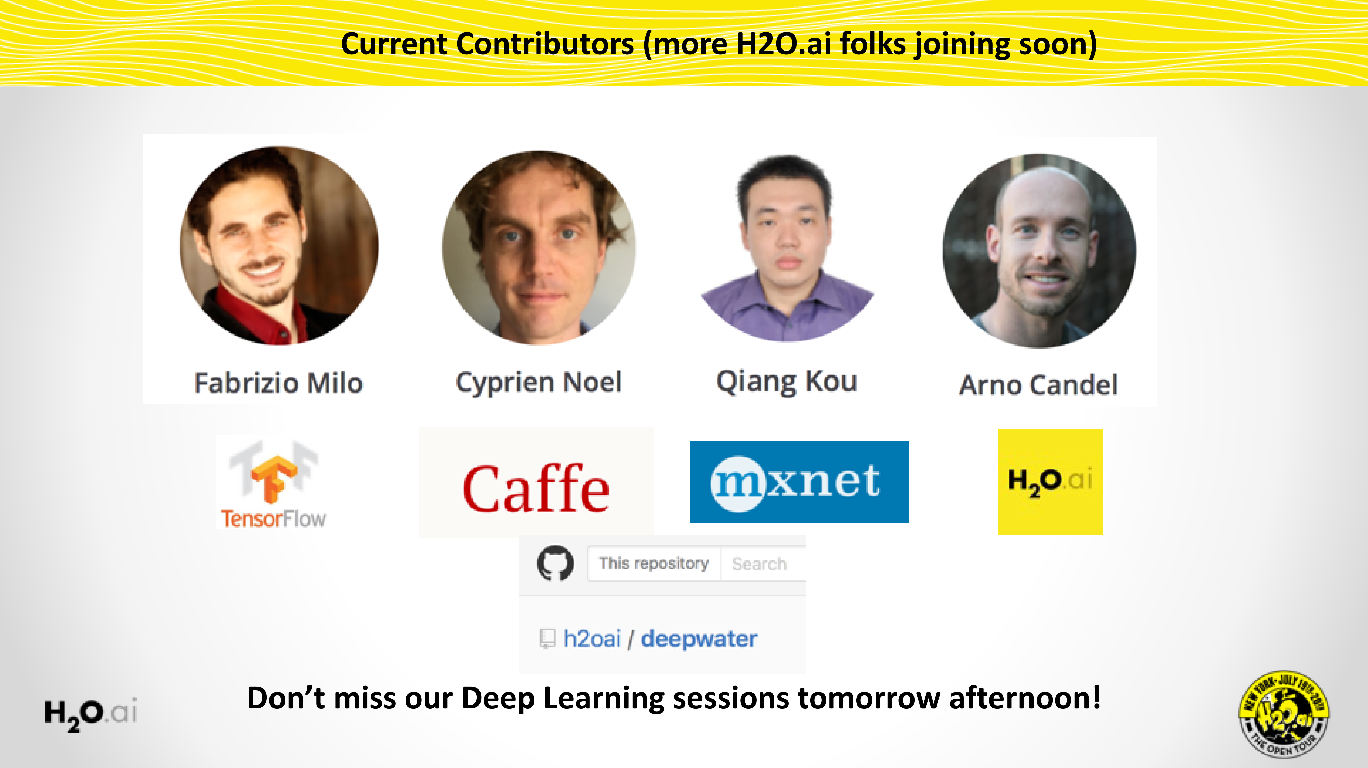
Deep Water opens the Floodgates for State-of-Art Deep Learning
14

Slide 15
Deep Water Demos

Slide 16
Deep Water Demos
H2O + mxnet
Dataset:
Cat / Dog / Mouse
H2O Python interface
mxnet GPU backend
Train a LeNet (CNN) model
Explore model in Flow
H2O + TensorFlow
Dataset:
MNIST hand-written digits
Sparkling Water + Jupyter Notebook
Convert TensorFlow model into H2O
Explore models in Flow

Slide 17
For Online Audience
H2O + mxnet
bit.ly/h2o_paris_1
demo_03_mxnet
H2O + TensorFlow
bit.ly/h2o_paris_1
demo_04_tensorflow

Slide 18
H2O + mxnet

Slide 19
H2O + TensorFlow

Slide 20


Thanks!
Jiqiong (Ji) Qiu
Franck Bardol
Igor Carron
Slides & Code
bit.ly/h2o_paris_1
Contact
joe@h2o.ai
@matlabulous
github.com/woobe

